Slide 1
Year 7 Knowledge Organiser
French
Term 1
Greetings
Numbers and Telling the Time
Days, Months and Seasons
Birthdays
Age

Slide 2
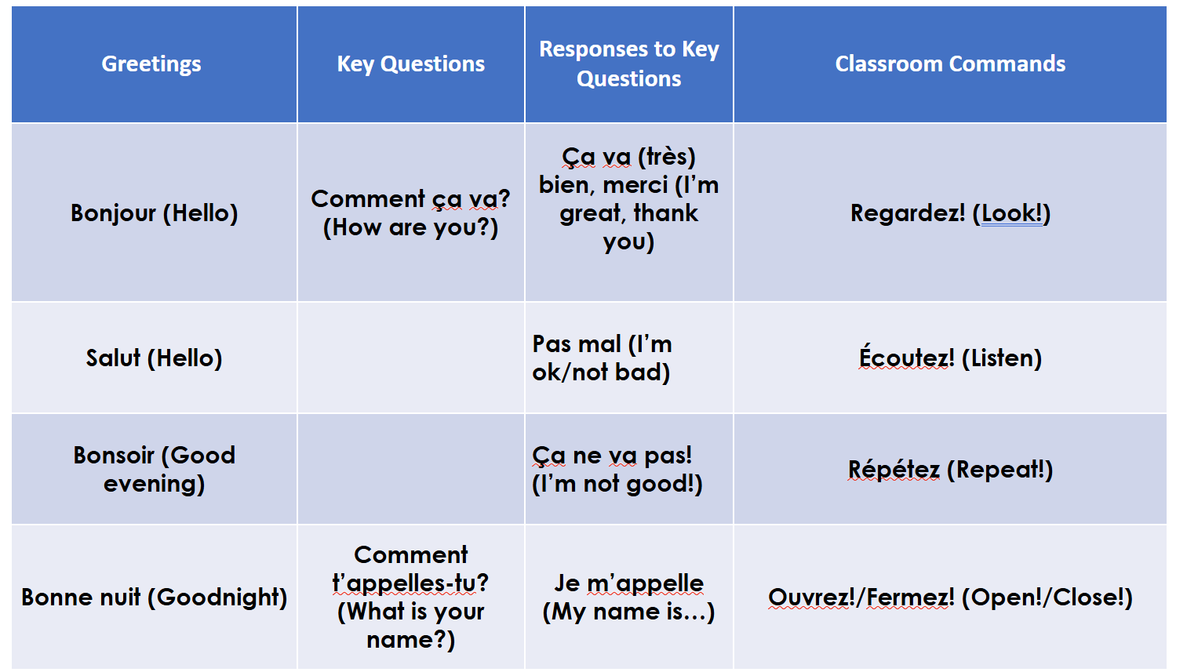
Greetings and Class Commands

Slide 3
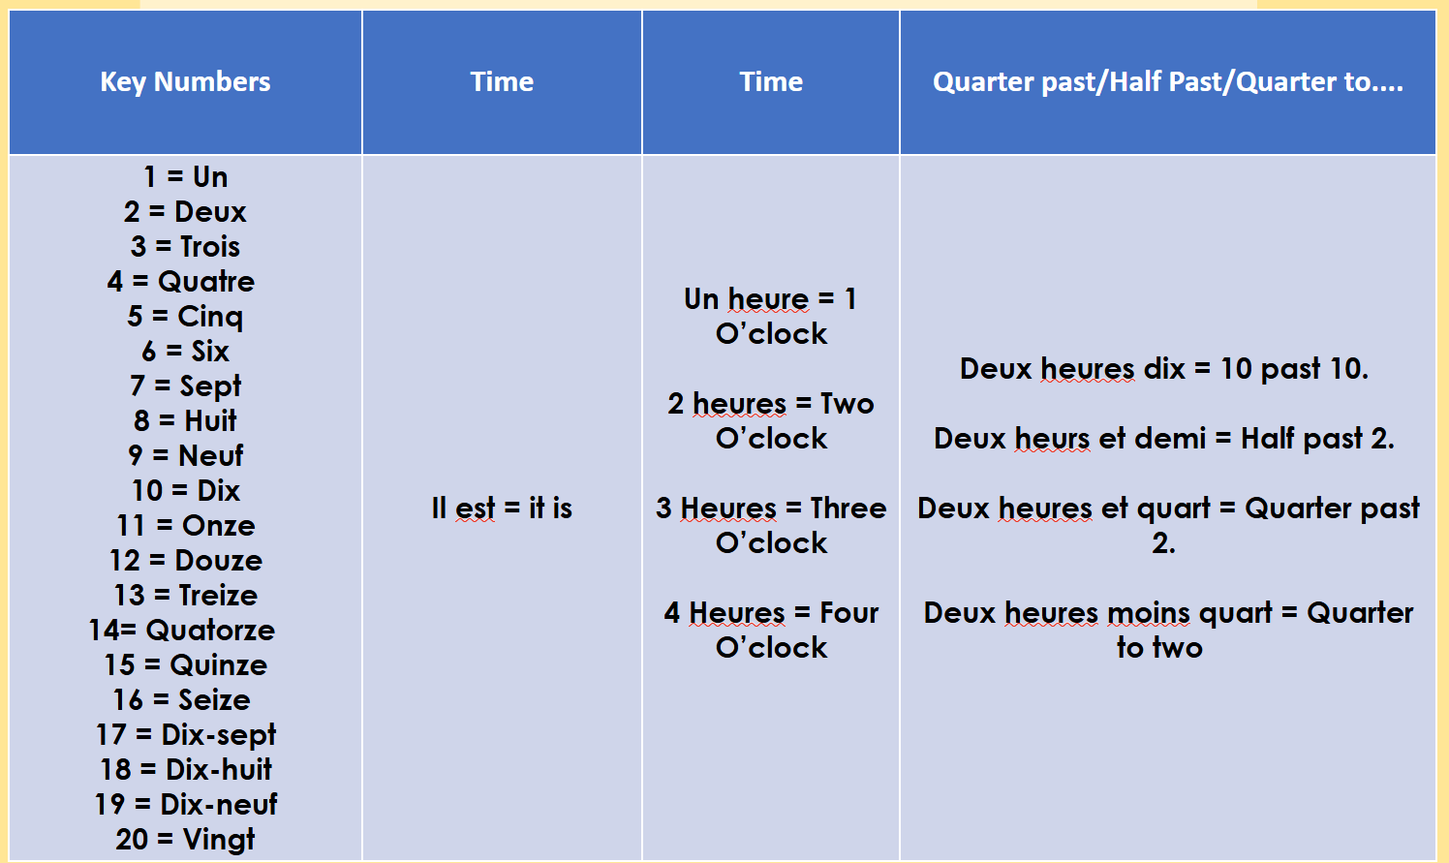
Numbers and Telling the Time.

Slide 4
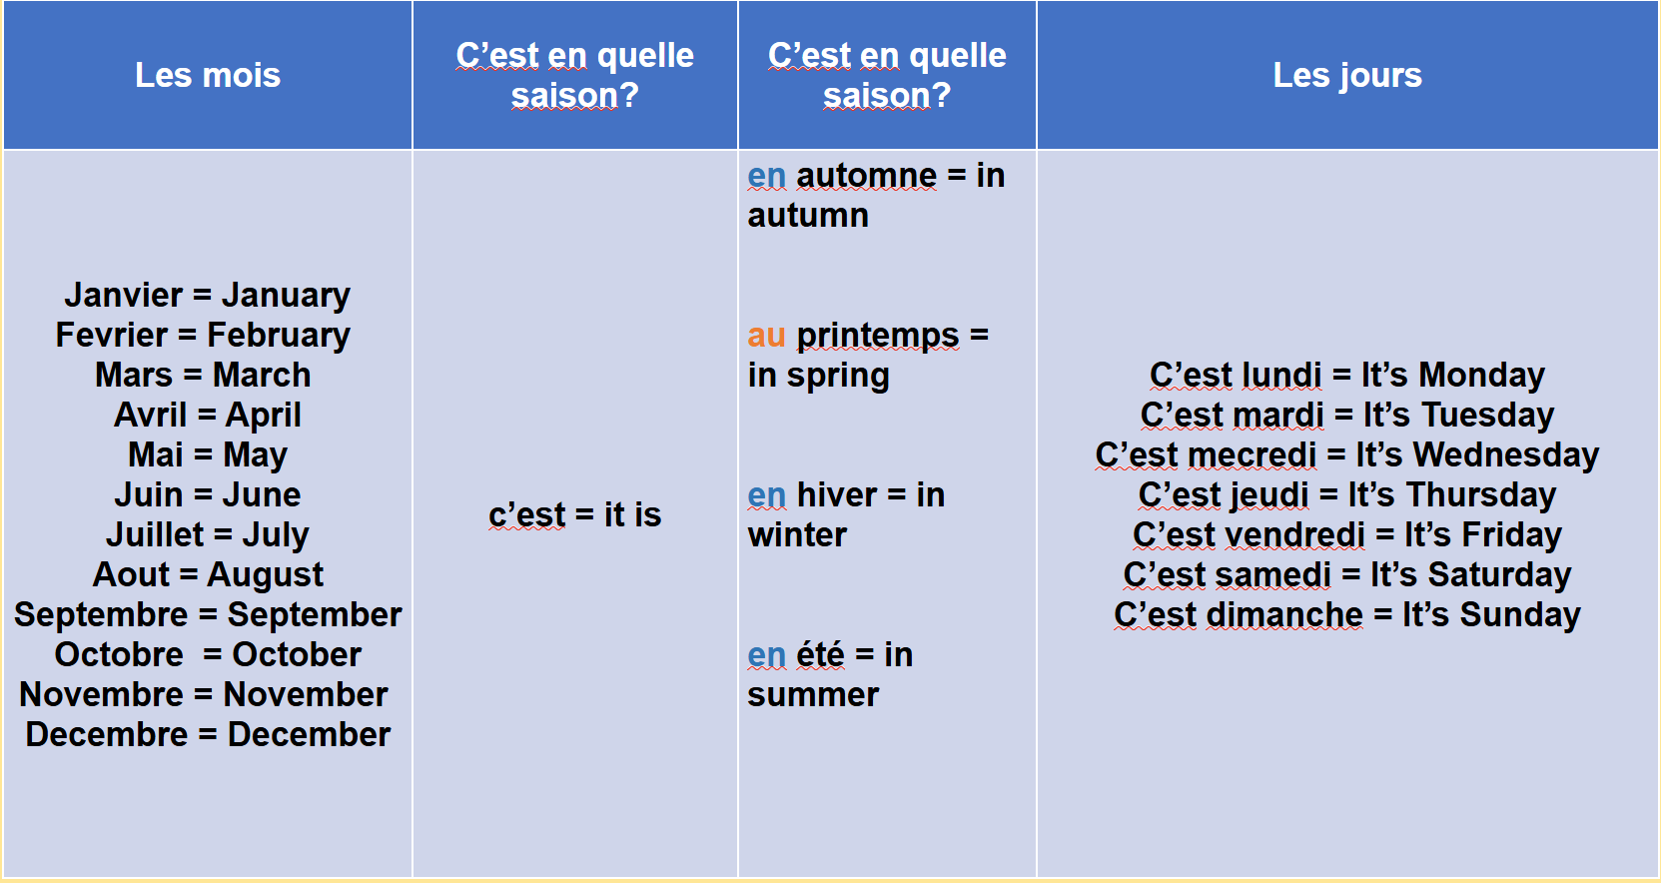
Days, Months, and Seasons.

Slide 5
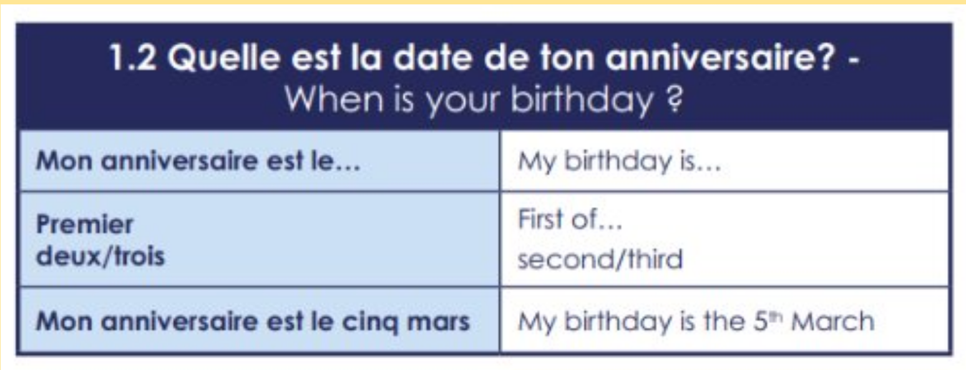
Birthdays

Slide 6
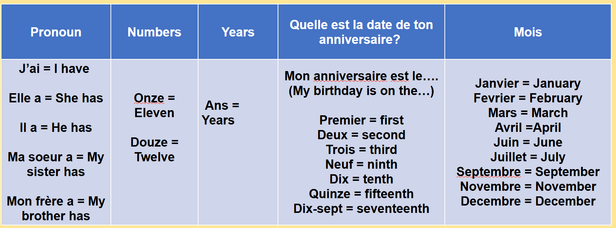
Age

